Slide 1
CoPilot Safe Assist
Software Engineering 2: Project Teamwork Mälardalen University
Optimus Octavian
Steering Group Meeting Nr.6

Slide 2
Last week

Slide 3
Last week’s plan
Implementation (backend) √
Application (classes and functionalities)
Web Page (partially)
CoPilot device communication √
Design description presentation √
Notes:
Deliverables = prototype + design description
Client meeting = get the device

Slide 4
Monday Meeting
- Updated trello with the new task for the week
- Task division on each member
- General discussion on work progress

Slide 5
Group skype meeting
- Decided on members presenting on steering meeting
- Discussed on tasks finished
- Shared some tasks on who is helping who to accomplish this week plan
- Decided who is conducting the online Client meeting today, what will be discussed

Slide 6
Other
Received documentation and CoPilot key files from MDH Contact
- Send the report to the Volvo Client and got feedback today, which will be considered for next steering group meeting.

Slide 7
Implemented classes
AlarmData
AlarmService
Constants
Controller
CoPilot
FirstPage
GeoLocation
GPSService
ServerCom
HandheldDevice
Unit
StartScreen
Login
Web page

Slide 8
Worked hours
Members | Worked Hours this week | Total of Worked Hours
Alvaro | 7 | 49
Dara | 6 | 73
Fernando | 9 | 82
Jonas | 16 | 80
Pablo | 9 | 70
Rickard | 36.5 | 114
Sidorela | 23 | 98
Vasja | 7 | 70

Slide 9
This week

Slide 10
This week’s plan
Skype meeting with the Client
Code Revision
Notification test(Vibration, sounds,colours of heads up)
Finish Web Backend
Beta-testing
Notes:
Deliverables = prototype + design description
Client meeting = get the device

Slide 11
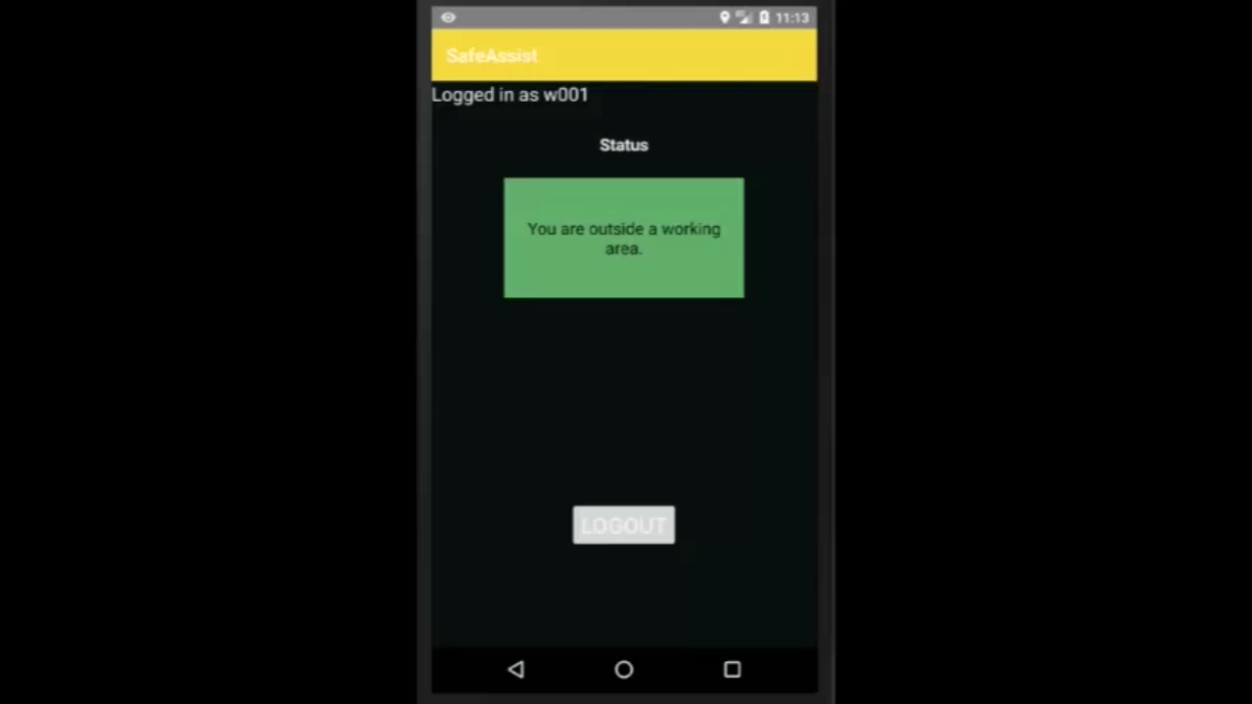
Demo video
Notes:
Deliverables = prototype + design description
Client meeting = get the device

Slide 12
Thank you!!

